Slide 1
Object Oriented Programming
(SENG6022)
Arba Minch University
Institute of Technology
Faculty of Computing & Software Engineering
Mr. Addisu M. (Asst. Prof)
G2 SE - Regular

Slide 2
Chapter 1
Introduction to OOP

Slide 3
Outline
Overview of OOP
Why Java?
Basic concepts of OOP
Classes
Objects
Members
Class member visibility
Encapsulation, inheritance and polymorphism

Slide 4
Many Aspects of Programming
Programming is problem solving
  always trying to make computer to do something useful — i.e., finding an optimal travel route
Programming is controlling
  computer does exactly what you tell it to
Programming is teaching
  computer can only “learn” to do new things if you tell it how
Programming is creative
  must find a good solution out of many possibilities
Programming is abstraction
  identify important features without getting lost in detail

Slide 5
What’s a Program?
Sequences of instructions expressed in specific programming language:
  syntax: grammatical rules for forming instructions
  semantics: meaning/interpretation of instructions
Instructions written (programmed/coded) by programmer
  coded in a specific programming language
  as a result, programs cannot be ambiguous
  all instructions together are called source code
  Executed by computer by carrying out individual instructions

Slide 6
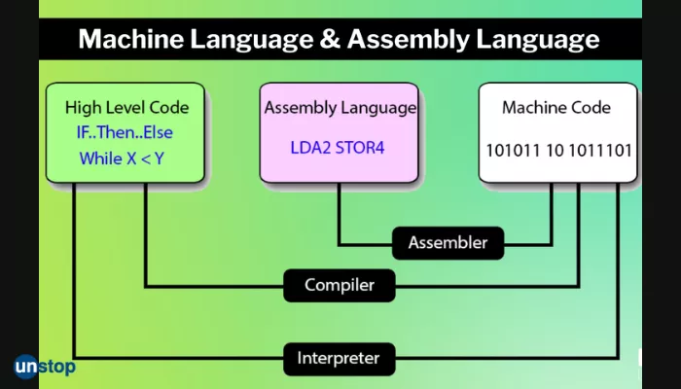
Programming Languages

Slide 7
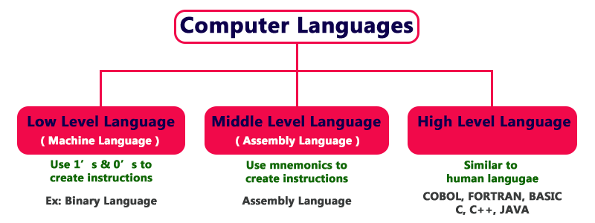
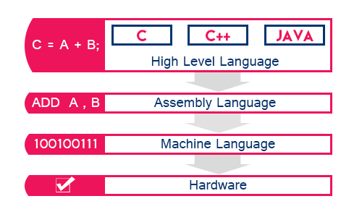
Programming Languages

Slide 8
Programming Languages
Programming language is an artificial language that can be used to instruct digital devices to behave a certain way
Like human languages, each programming language has its vocabulary, syntax and other linguistic rules.
Machine language
  machine is short for computing machine (i.e., computer)
  computer’s native language, sequence of zeroes and ones (binary)
  different computers understand different sequences
  hard for humans to understand: 01010001…

Slide 9
Programming Languages
Assembly language
  mnemonics for machine language
  low level: each instruction is minimal
  still hard for humans to understand: ADD d0,d2
High-level language
  FORTRAN, Pascal, BASIC, C, C++, Java, etc.
  high level: each instruction composed of many low-level instructions
  closer to English easier to read and understand:
    hypotenuse = Math.sqrt(opposite * opposite + adjacent * adjacent);

Slide 10
Interpreting Vs Compiling Programs
Each type of computer only “understands” its own machine language (zeroes and ones)
Thus, we must translate from High-level to machine language
team of experts programs a translator, called a “compiler” which translates entirety of a High-level language program to an executable file in computer’s native machine language.
Running :
  compilation: Your program → executable
  execution: run executable
    machine executes the program by “running” each machine language instruction in the executable file

Slide 11
Interpreting Vs Compiling Programs
An alternative to compiling your program is - to interpret your program
  each line of your program is translated into machine language and immediately executed
E.g., translating between natural languages
  Compiler: human translator translates book in its entirety and then translated book is printed and read
  Interpreter: human interpreter translates each spoken statement in sequence as speaker is speaking

Slide 12
Programming Paradigm
computer program usually consists of two elements:
  Data – characteristics
  Code – action
Paradigm: a philosophical or theoretical framework of any kind".
    Paradigm is "ways of organizing thought".
Programming paradigm
The basic structuring of thought underlying the programming activity.
Object Oriented Programming is a paradigm that provides many concepts such as inheritance, data binding, polymorphism etc.

Slide 13
Programming Paradigm
programming paradigm is a fundamental style of programming
Unstructured Programming
Procedural programming
Structured Programming
Object Oriented Programming

Slide 14
Object Oriented Programming System
OOP is a methodology or paradigm to design a program using classes and objects
    a way to organize and conceptualize a program as a set of interacting objects
    simplifies the software development and maintenance
    programmer defines types of objects that will exist.
    programmer creates object instances as they are needed
    programmer specifies how these various object will communicate and interact with each other

Slide 15
Object Oriented Programming System
Object
  Any entity that has state/attributes & behavior/methods
    Method: an action performed by an object (a verb)
    Attribute: description of objects in a class
  can be physical and logical
  For example: chair, pen, table, keyboard, bike etc.
      Dog
            Attributes: breed, color, hungry, tired, etc.
            Behaviors: eating, sleeping, etc.
      Bank Account
            Attributes: account number, owner, balance
            Behaviors: withdraw, deposit
Class
  Collection of objects is called class
  a category of similar objects (such as automobiles)

Slide 16
Design Principles of OOP
Four main design principles of OOP:
Encapsulation
Abstraction
Polymorphism
Inheritance

Slide 17
Design Principles of OOP
Inheritance:- When one object acquires all the properties and behaviors of parent object
  It provides code reusability
  It is used to achieve runtime polymorphism
Polymorphism:- When one task is performed by different ways
  The same word or phrase can mean different things in different contexts
  In English, bank can mean side of a river or a place to put money
  E.g.: to speak something e.g. cat speaks meaw, dog barks etc.

Slide 18
Design Principles of OOP
Abstraction:- Hiding internal implementation details of an object and showing functionality
  E.g., Vehicle class with drive and stop methods
    details of how these methods work are hidden from the user, so they can simply call the methods and trust that they will work as expected
  In java, we use abstract class and interface to achieve abstraction
Encapsulation:- process of hiding information within an object so that it cannot be accessed directly from outside the object
  allows you to control how data is used and prevents accidental modification of data
  helps to keep your data safe and secure

Slide 19
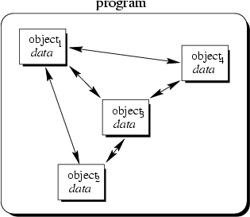
Object Oriented Programming-OOP
a method of implementation in which programs are organized as cooperative collections of objects
Data and operations are grouped together
Each object is capable of receiving messages, processing data, and sending messages to other objects
write programs by modelling problem as set of collaborating components
  determine what the building blocks are
  then put them together so they
  cooperate properly

Slide 20
What is java?
Java is an OOP language and platform.
Since java has its own runtime environment (JRE) and API, it is called platform
  Platform is any hardware or software environment in which a program runs.
java platform has two parts
  Java Application Programming Interface (Java API)
    Java API is a large collection of ready-made software components
  Java Virtual Machine (Java VM)

Slide 21
What is java?
Language Characteristics
Object oriented
Portable
High performance
Compiled and Interpreted
Multithreaded
Robust
Extensible
Simple
Familiar
Architecture neutral
Dynamic
Secure

Slide 22
Java Simplicity
Initial design goals was to be small and simple,
    easier to write, easier to compile, easier to debug, and, best of all, easy to learn
Syntax and object-oriented structure is borrowed from C++
More complex parts of those languages have been excluded
    not support the struct, union, and pointer data types
    not support multiple inheritance
    handles command-line arguments differently than C or C++.
    has a String class
        This differs from the null-terminated array of characters

Slide 23
Java Simplicity
There are no pointers in Java, nor is there pointer arithmetic
Memory management is automatic
  Java takes care of referencing and dereferencing memory objects
  An automatic grabage collection mechanism manages allocation and freeing of memory
Array indexes, object types, and casting between different objects are always validated at compile-time and run-time

Slide 24
Java Program Structure
public class Sample
{
public static void main(String args[ ])
{
System.out.println(“ Hello, world”);
}
}

Slide 25
Java access modifiers
  restricts the access of a class, constructor, data member and method in another class
  In java we have 4 access modifiers
Default
  If you don’t use any modifier, it is treated as default by default.
  accessible only within class
Private
  accessible only within class
Protected
  accessible within package and outside the package but through inheritance only
Public
  accessible everywhere
  widest scope among all other modifiers.

Slide 26
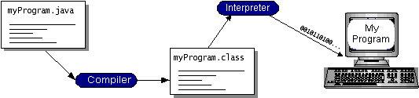
Java Virtual Machine (JVM)
Java is both compiled and interpreted
  compiler - translate a program into an intermediate language called Java bytecodes
  interpreter - parses and runs each Java bytecode instruction
Compilation happens just once; interpretation occurs each time the program is executed
JVM is responsible in interpreting bytecode to machine understandable code
Java slogan - write once, run anywhere

Slide 27
Development Tools for Java
purpose of the JDK (Java Development Kit) - to provide a complete set of tools for development, testing, documentation, & execution of Java programs & applets
Some of the programs in JDK are the following
  javac - Java language compiler, which converts your Java source code into Java Bytecode
  java - Java language interpreter, which you may use to run Java application programs and applets.
  javadoc – Creates an API documentation in HTML format from the Java source code
  Appletviewer - displays Java applets

Slide 28
Development Tools for Java
Many vendors provide tools to leverage Java development
  Visual Café – Symantec
  Jbuilder – Borland
  Visual Studio J++ - Microsoft
  Netbeans, Eclipse, JCreator, JBeans, etc

Slide 29
Types of Java Applications
Standalone Application - also known as desktop application or window-based application
  An application that we need to install on every machine such as media player, antivirus etc.
  AWT and Swing are used in java for creating standalone applications (GUI)
Web Application - An application that runs on the server side and creates dynamic page
  servlet, jsp, struts, jsf etc. technologies are used for creating web applications in java.

Slide 30
Types of Java Applications
Enterprise Application - An application that is distributed in nature, such as banking applications etc.
  It has the advantage of high level security, load balancing and clustering.
  In java, EJB (enterprise java bean) is used for creating enterprise applications.
Mobile Application - An application that is created for mobile devices.
  Android and Java ME (Micro Edition) are used for creating mobile applications.

Slide 31
The End!
Questions, Ambiguities, Doubts, … ???

